Slide 1
Lecture 4: Why Tech Dev?
Michael MacCoss
maccoss@uw.edu

Slide 2
Technology uses science to solve problems, and science uses technology to make new discoveries. However, technology and science have different goals. The goal of science is to answer questions and increase knowledge. The goal of technology is to find solutions to practical problems.

Slide 3
Telescope
Hans Lippershey invented the telescope in eary 1600s. Galileo improved on the design
Galileo’s telescope changed what we could see
Observed craters on the moon
Discovered Jupiter had moons and Saturn had rings
Sun was at the center of the solar system
Relied on science
Lippershey and Galileo used knowledge of light and lenses
Each telescope design refined on the scientific knowledge gained from prior technology development
Microscope had a similar effect

Slide 4
Technology Development Uses Testable Ideas
Antenna was developed to test hypotheses about how electricity and magnetism work.
If the antenna had worked differently, it would have prompted a re-examination of that basic knowledge
Failures lead to new ideas and new technology developments.
Example: Hubble telescope originally had a mirror that had the wrong curve.
New technology inspires ongoing research and improves the technology

Slide 5
New directions in science are launched by new tools much more often than by new concepts.
The effect of a concept-driven revolution is to explain old things in new ways.
The effect of a tool-driven revolution is to discover new things that have to be explained.
Freeman J. Dyson

Slide 6
The last 40 years have seen a revolution in analytical instrumentation
Examples:
4 color sequencer (Lee Hood, Lloyd Smith, Mike Hunkapillar, Tim Hunkapiller)
Electrospray ionization MS (John Fenn, Nobel Prize)
Overcoming the diffraction limit in fluorescence microscopy (Betzig, Hall, and Moerner, Nobel Prize)
Protein Structure Determination by NMR (Kurt Wuthrich, Nobel Prize)
Cryo-Electron Microscopy
Massively parallel sequencing (aka NGS) (Church, Mitra, Shendure, etc..)
What tools have shaped your research? How have they changed in the last decade?

Slide 7
What needs to be measured?
Who – Need methods that can determine the identity of molecules in a mixture
What – Assess function and Role
Where – Localization
Intracellular
Intercellular
When – At all points and time and under different perturbations
With Whom – Determine interactions between molecules
How much – Assess quantities
Stability – Production and Disposal

Slide 8
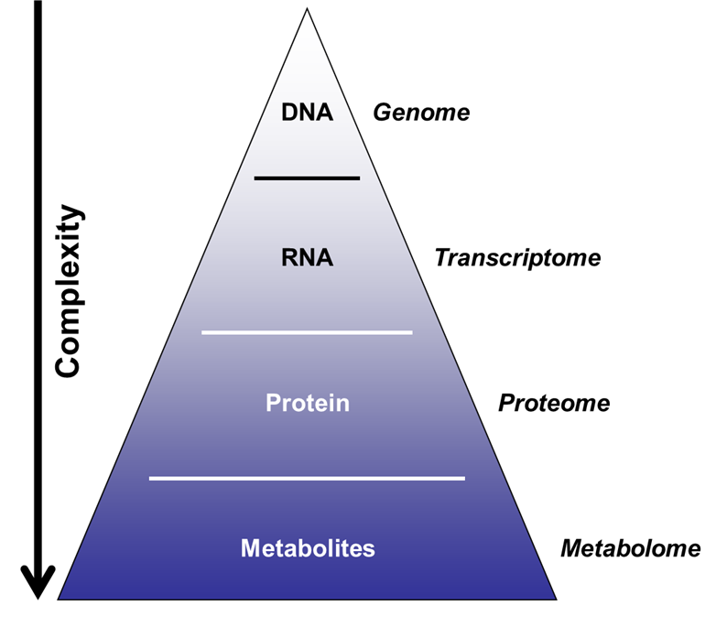
Major Biological Macromolecules Classes
Nucleic acids
DNA and RNA
Storage and transfer of genetic information
Proteins
Enzymes, hormones, antibodies, catalysts, structure, transport, motor, toxins
Carbohydrates
Energy source, structural, signaling
Lipids
Energy, compartmentalization, signaling

Slide 9
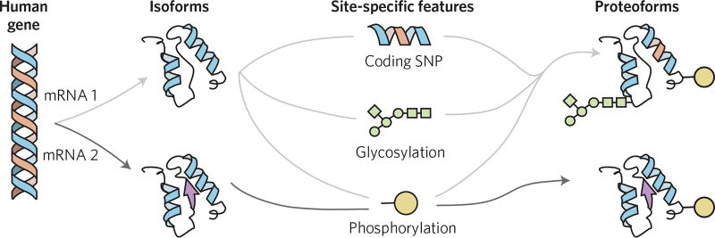
Proteins are complicated by PTMs
Aebersold et al, Nat Chem Biol, 2018

Slide 10
Spatial Heterogeneity
Outcome/result
Tissue sample
Bulk measurement

Slide 11
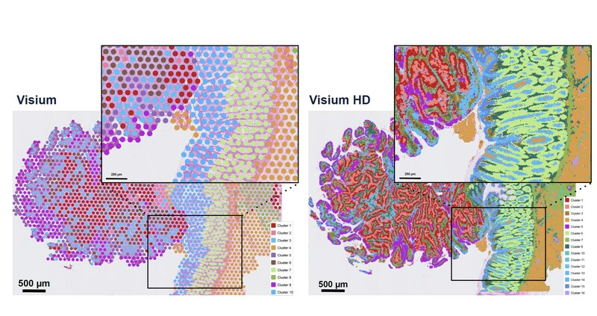
5,000 measurements at 50 µm resolution
11 million measurements at 2 µm resolution

Slide 12
Experimental limitations remain a challenge for spatial and low input proteomics
Spatial approach
Spatial samples are only a small fraction of the bulk aggregate samples
Tissue sample
Input
material
Throughput
Sensitivity
4

Slide 13
Single cell measurements can provide insights into cellular heterogeneity but loses spatial information
Single cell approach
Outcome/result
Single cell measurement
Tissue sample
vs
Aggregate Bulk
3

Slide 14
Localization can complicate quantitation

Slide 15
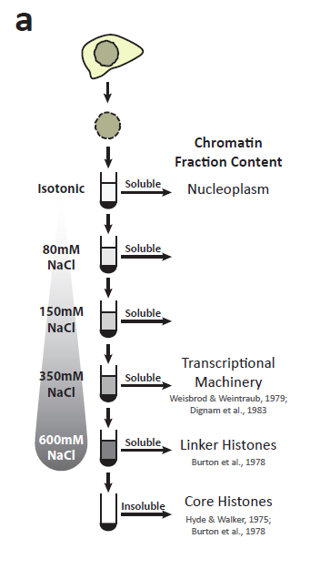
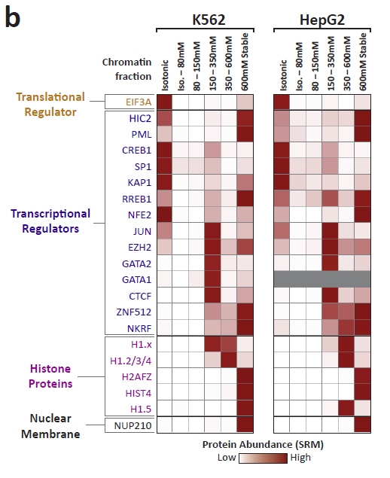
Segregation of transcription factors into discrete chromatin compartments
Data Andrew Stergachis

Slide 16
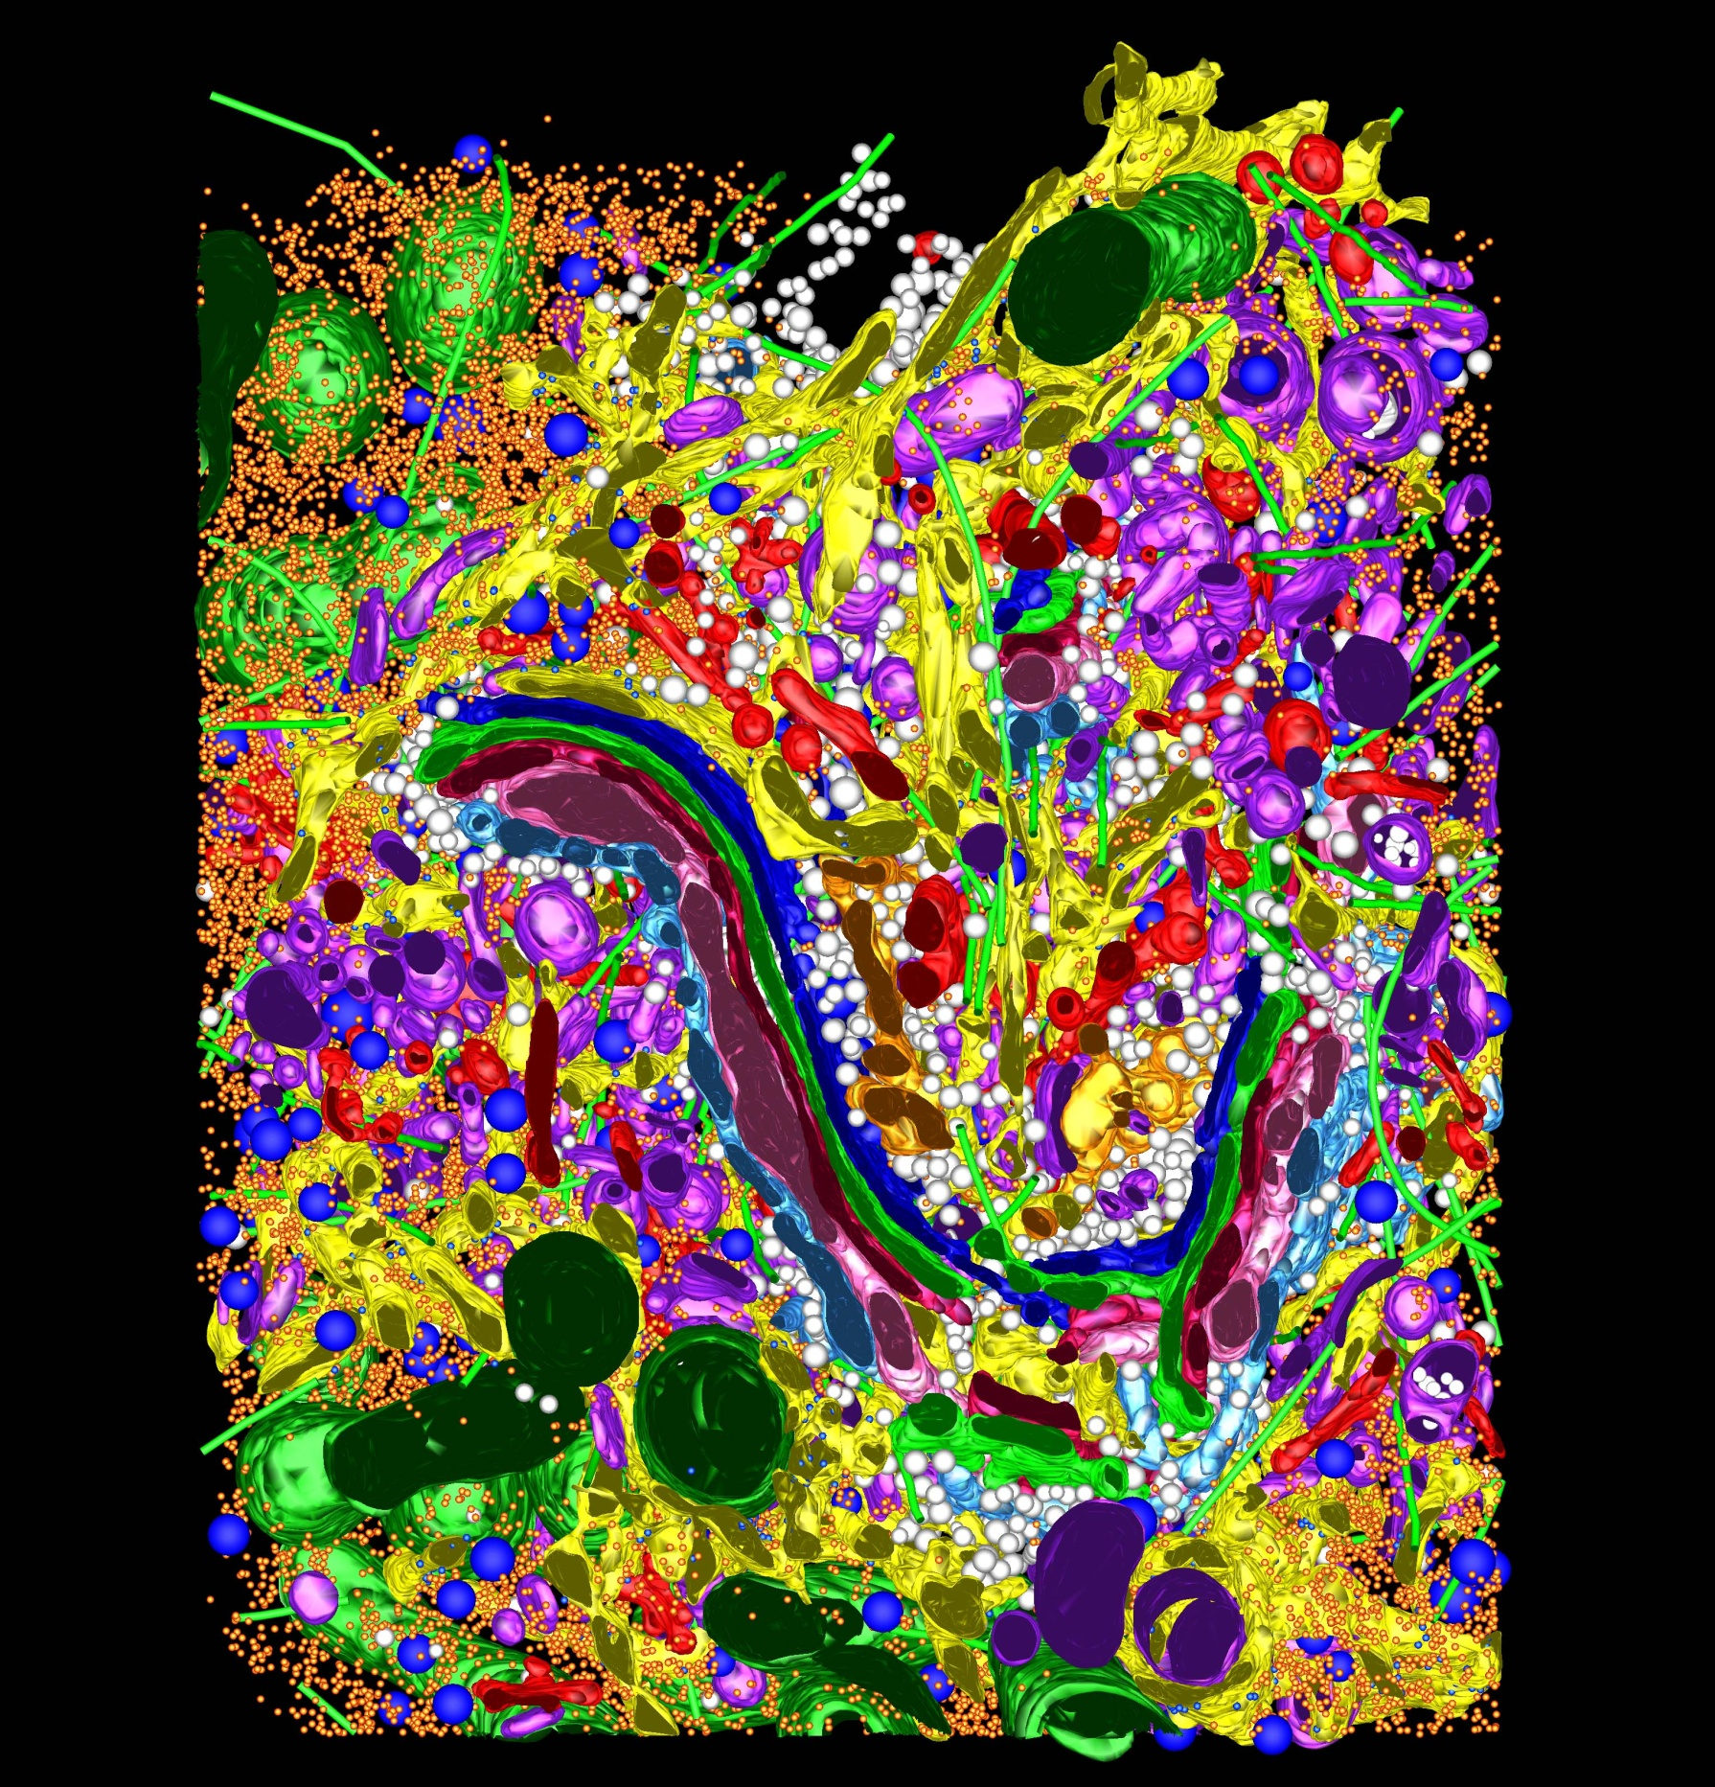

Slide 17
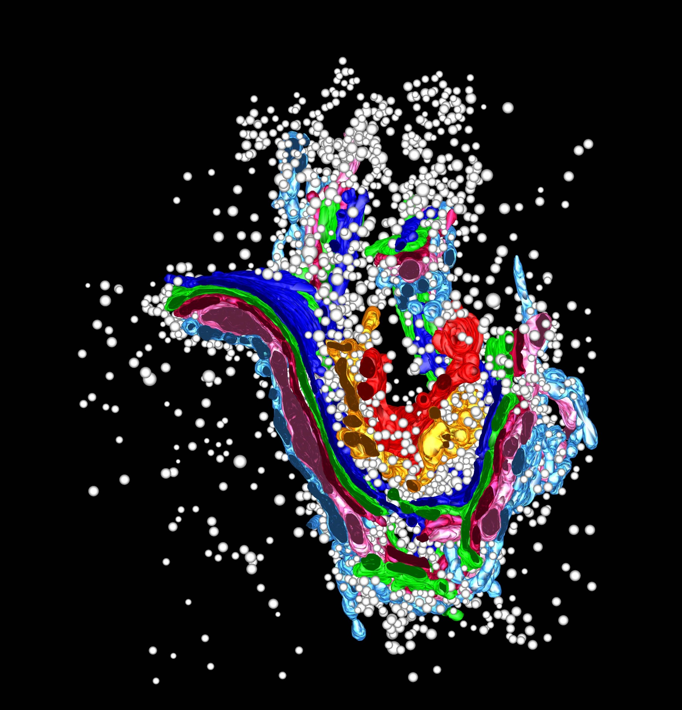

Slide 18
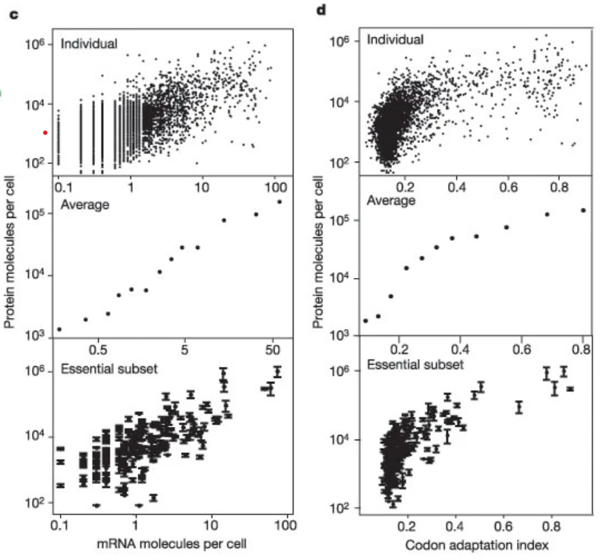
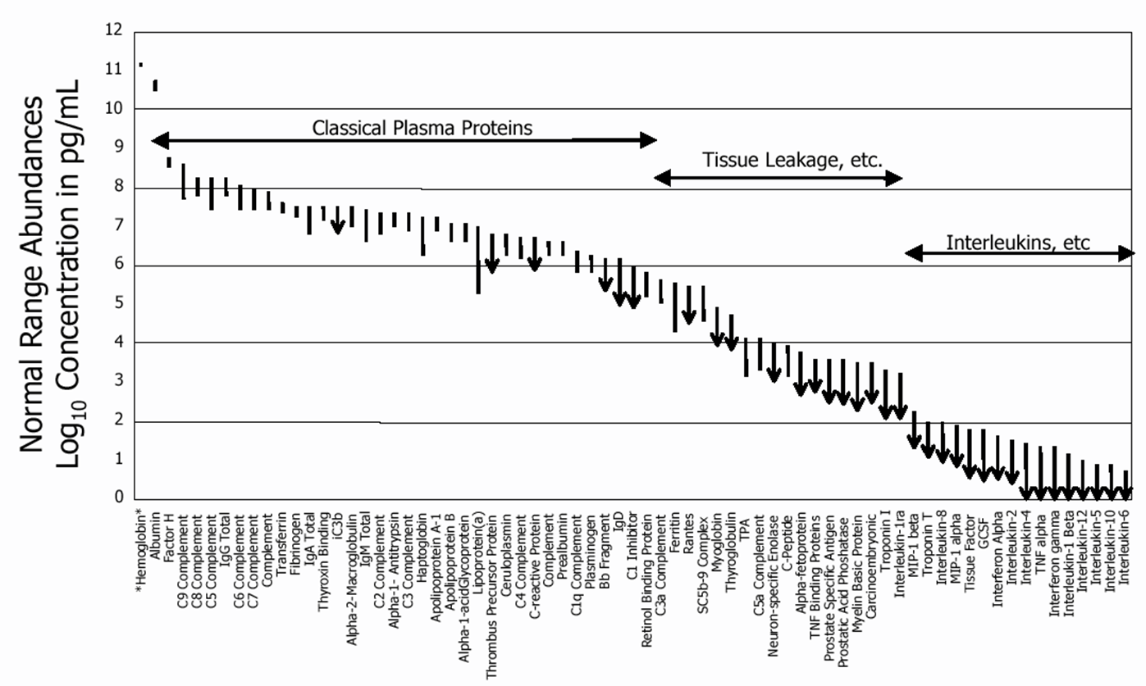
Dynamic Range
21 Proteins Represent 99% of the Blood Protein Mass
The proteome spans a dynamic range of 10^6 to 10^12
Ghaemmaghami et al, Nature 2003
Anderson and Anderson, Molecular and Cellular Proteomics 2002

Slide 19
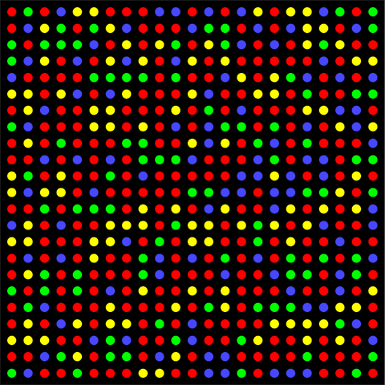
Lots and Lots of Molecules
400,000 mRNA molecules per cell = 40 million reads
Average transcript at ~5-10 copies
10,000,000,000 protein molecules per cell = 1 trillion reads
Average protein at 10⁴ to 10⁵ copies
Fluorescent wavelength = 200 – 750 nm
Leads to a practical density of ~1 µm
1 million reads: 1 mm²
100 million reads: 1 cm²
10 billion reads: 10 cm²
1 trillion reads: 1 m²
Scaling in Powers of 10 is Hard

Slide 20
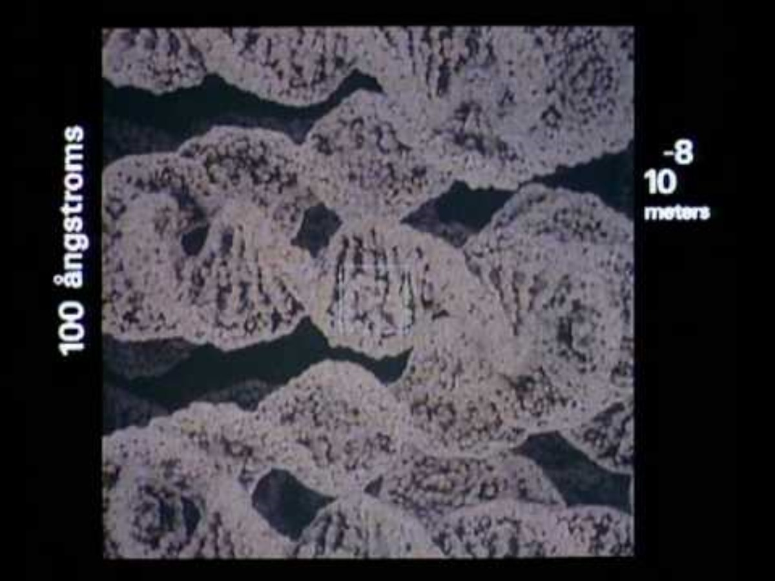

Slide 21
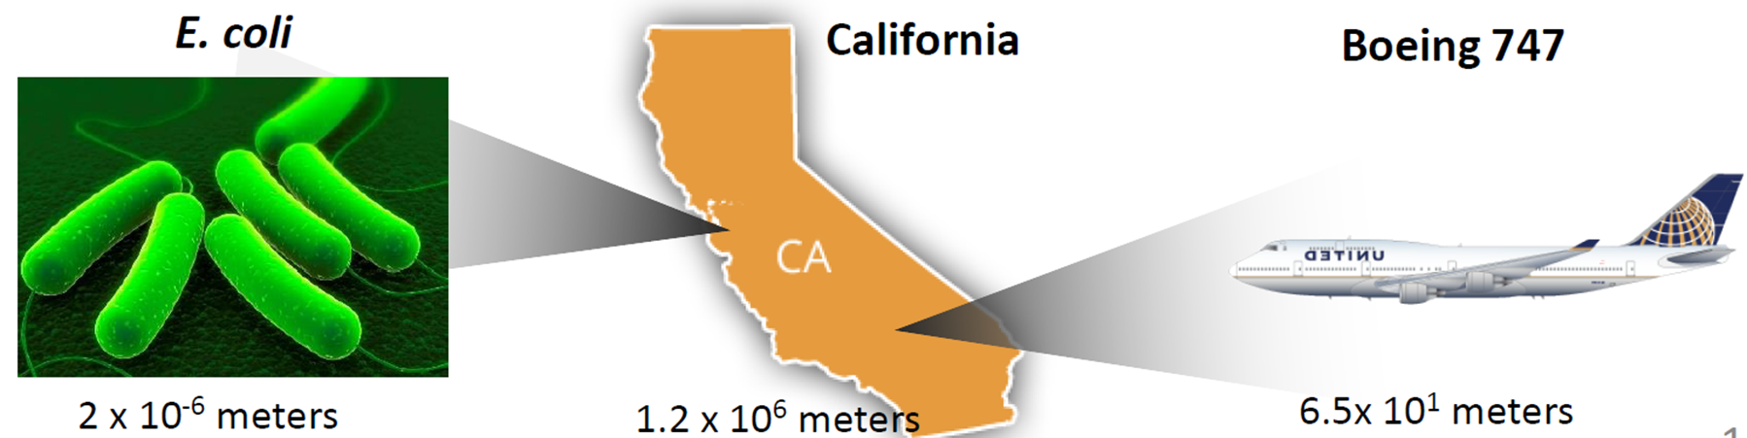
Where we need to be
Where we are at
If the most abundant protein represents the length of California, the least abundant proteins represent the length of E. coli. Most analytical methods only have 10⁴ to 10⁵ dynamic range. Representing the size of a 747.
Where we need to be to characterize the transcriptome: 4x10⁴ meters, ~marathon

Slide 22
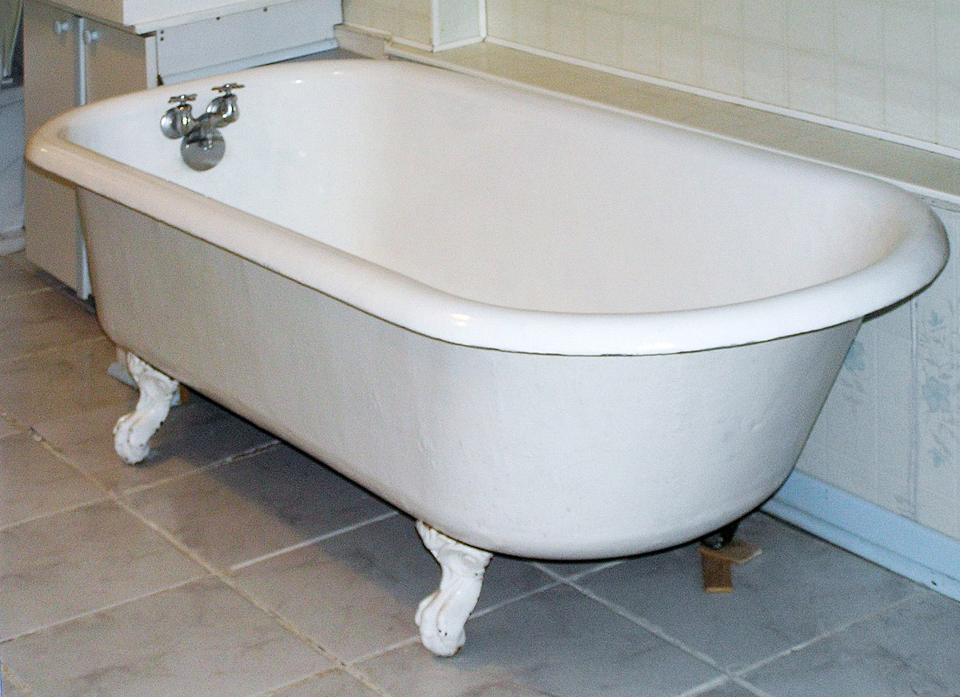
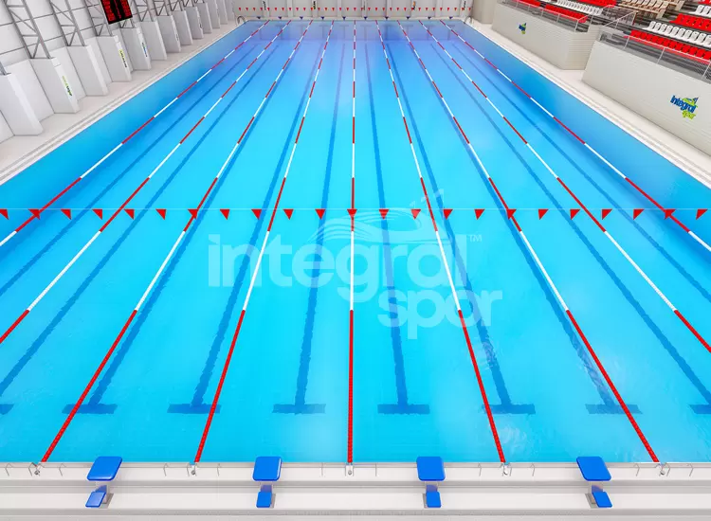
Measuring the volume of a swimming pool
80-100 liters (transcriptome)
2.5 million liters (proteome)

